Slide 1
Daniel Garces – Internship Summary Rapid automation – analysis for developers (RAAD)

Slide 2



Special Thank you
Intern Mentor:
Joe Tarango
IL Mentor:
Justin Gottschlich
Manager:
Jim Baca
Teammates:
Andrea Chamorro
Tyler Woods
Rogelio Macedo
PanteA Zardoshti
Sungkeun Kim
Stella Cao

Slide 3
Agenda
Review of tasks completed in the year-long internship
Details/figures of each deliverable
IDFs/granted patents/Distinguished Inventor Award

Slide 4


Overview of tasks completed
TSV library:
Created interface for automatically prepping a drive, loading a workload, and collecting telemetry (loadAndProbeSystem.py)
Created interface for selecting between multiple methods for collecting telemetry (generateTSBinaries.py)
Designed and implement system for efficiently extracting telemetry header (formatTS.py)
Designed and implement an efficient mechanism for aggregating and storing timeseries using a configuration file (formatTS.py)
Created an interface for graphing any telemetry object’s fields (visualizeTS.py)
Integrated matrix profile to generic graphing interface
Created an interface for graphing Defrag History (DefragHistoryGrapher.py)
Integrated all these systems into the GUI and autoModuleAPI
TSV = Time-Series Visualization

Slide 5
Overview of tasks completed
Parse library:
Integrate Auto-Parsers system into RAAD to successfully parse telemetry data (refactor pacmanIC.py)
Utilize the work of Randy Eike as a baseline to implement an NLOG parser
Integrate the NLOG parsing and aggregation mechanism into the autoModuleAPI and the GUI
Design and implement a system for aggregating NLOG events and filter them so that only errors are included in RAAD report
MEP library:
Implement ARMA prediction capabilities for forecasting telemetry data
Design and implement a stand-alone GUI for running the prediction system
Integrate ARMA prediction into autoModuleAPI and general GUI
MEP = Media-Error-Prediction

Slide 6
Overview of tasks completed
autoAI library (mediaPredictionRNN.py):
Create predictive model to forecast telemetry data values based on historical data
Implement sliding window generator to preprocess time-series data and generate input/output pairs for the model
Create interface for embedding input vectors to uncover potential relationships between categorical variables in the system
Integrate matrix profile into the system to change the representation of the input vectors and explore a hidden solution space under this new frame of reference
Generate a graphing module for displaying predictions and communicating model’s metrics to the user
Integrate the proposed systems to autoModuleAPI and the general GUI

Slide 7
Overview of tasks completed
autoAI library (nlogPrediction.py):
Create predictive model to nlog events using a combination of machine learning and NLP techniques
Implement a tokenizer for processing nlog descriptions and generating regex mappings for faster processing of nlog events inputted into the system
Leverage pre-trained BERT model for generating embeddings for nlog descriptions
Create three independent neural network models to predict nlog parameters, nlog time stamps, and nlog embeddings respectively
Create a linear regression model for predicting number of nlog events that will change for a given time delta
Generate a data generator for extracting nlog events and formatting them in appropriate bundles to be digested by the models
Integrate the proposed systems to autoModuleAPI and the general GUI

Slide 8
Overview of tasks completed
Miscellaneous Tasks:
Implement the code for automatically generating documentation using the comments inside each function (implemented using sphynx)
Design and implement installer Wizard for easy environment management and faster ramp up for RAAD
Write a wiki guide about getting started with RAAD, including information about installing all the required software, creating a conda environment, and all the sections in the GUI
Create scripts for generating executables of the main GUI and the installer
Work with Rogelio to create a data preprocessing API (preprocessingAPI.py)
Help Media FW team with implementation of predictive model for statistical analysis and forecasting of RBER data
Participate in idea discussion with Intel Labs for integration of MISIM into RAAD, and utilization of NLOG Engine for code prediction

Slide 9
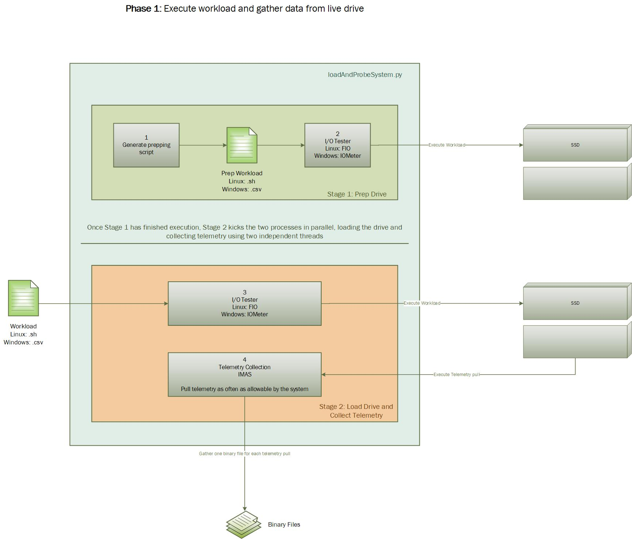
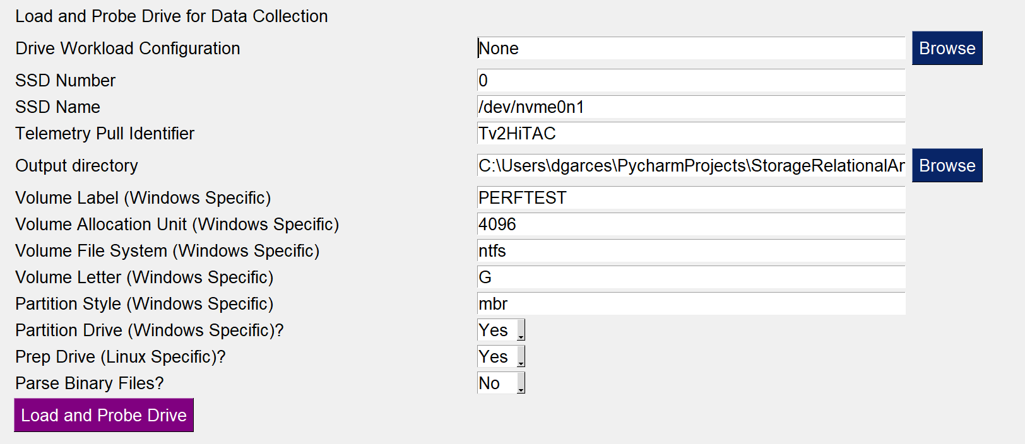
TSV Library – load drive
TSV = Time-Series Visualization
GUI snippet for loading and probing the drive
High level description of the load and probe system

Slide 10
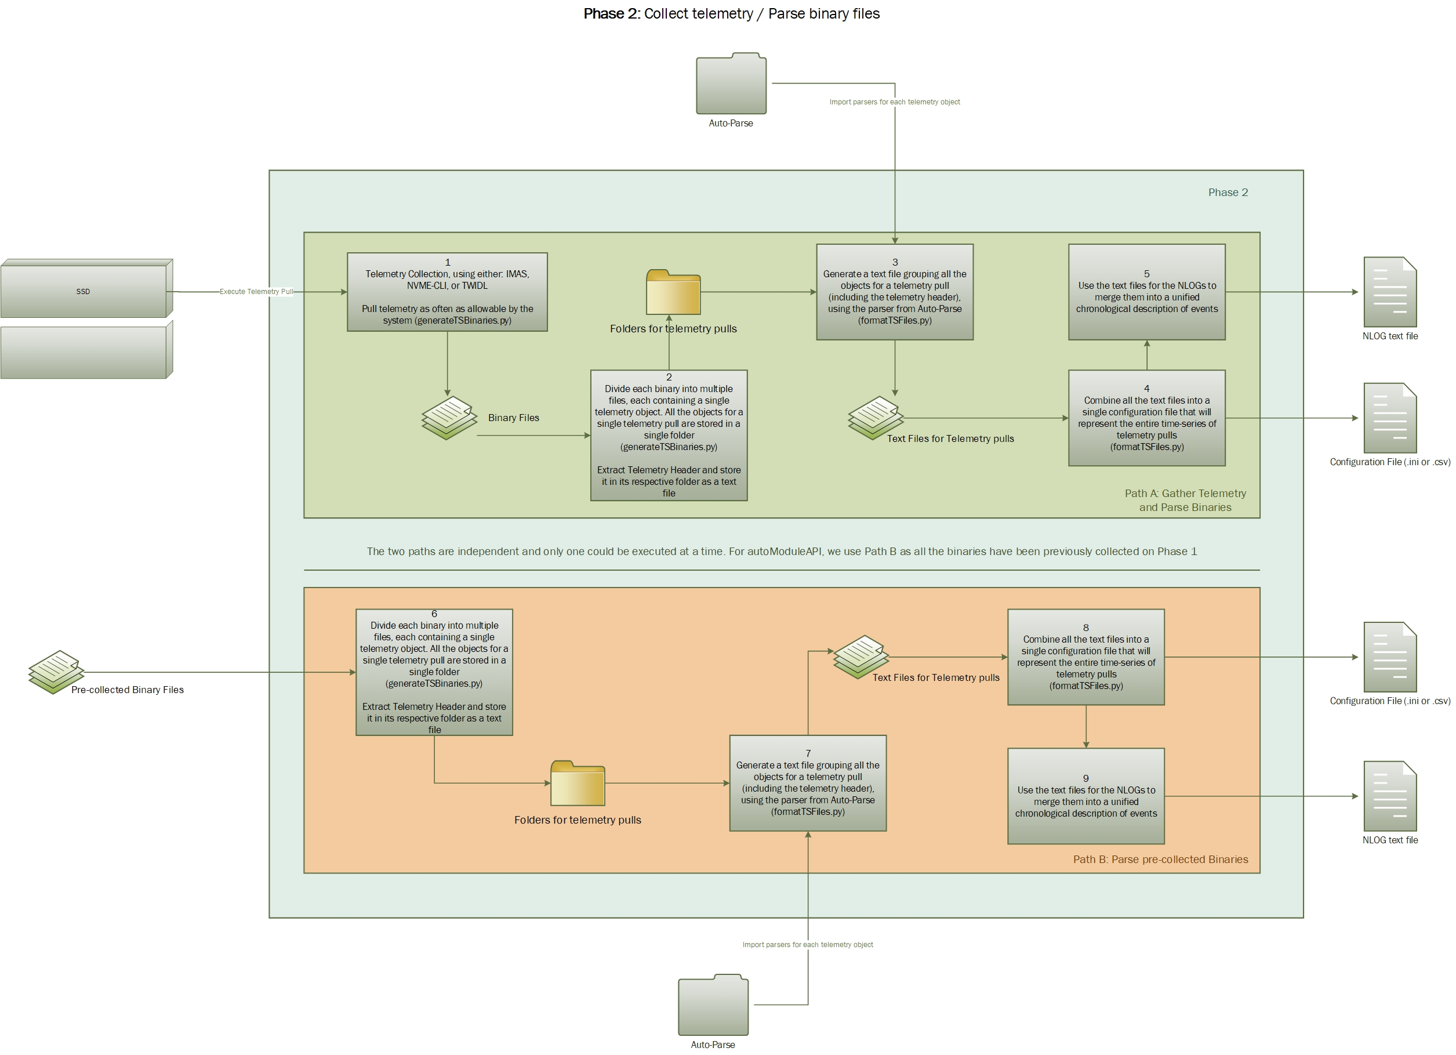
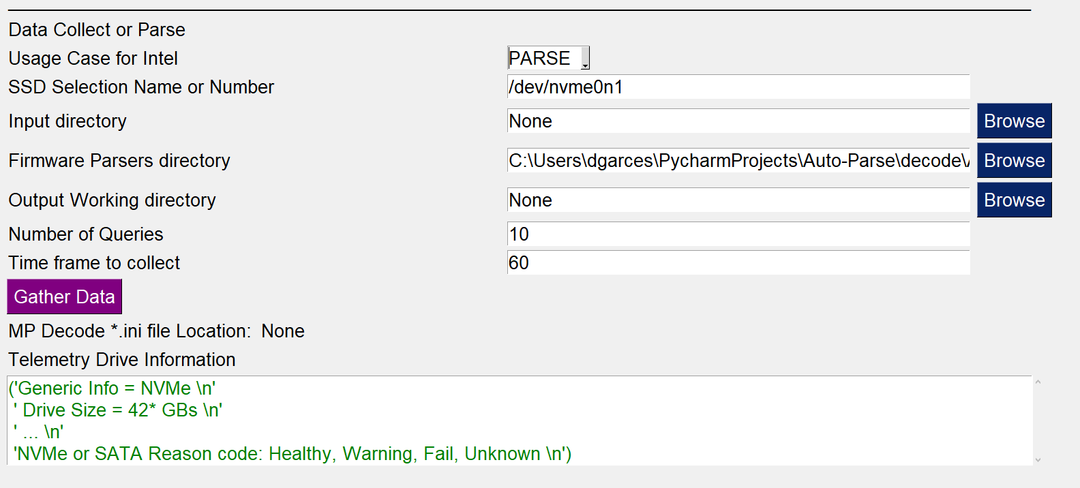
TSV Library – Collect Telemetry
TSV = Time-Series Visualization
GUI snippet for the telemetry collection
High level description for the telemetry collection system for different settings

Slide 11
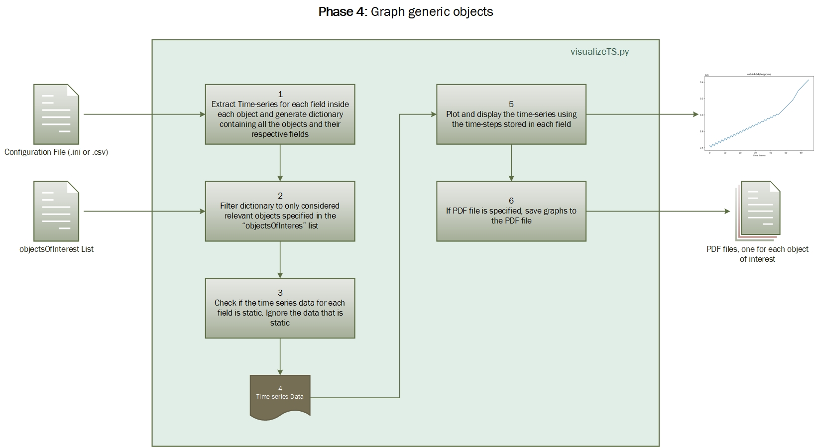
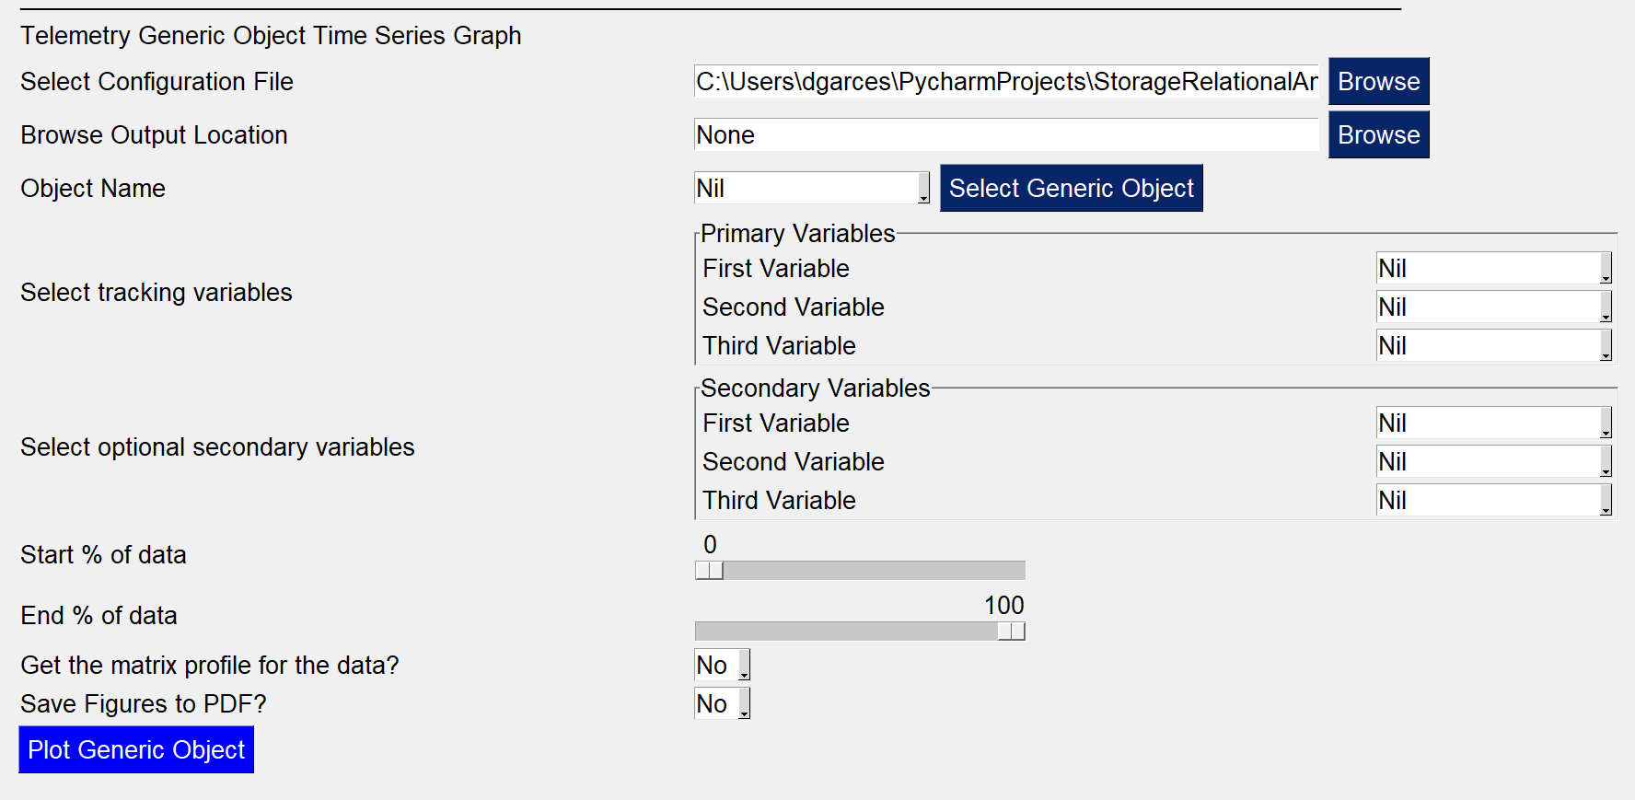
TSV Library – Generic Graphing
TSV = Time-Series Visualization
GUI snippet for the graphing of generic objects
High level description of the system for graphing generic objects

Slide 12
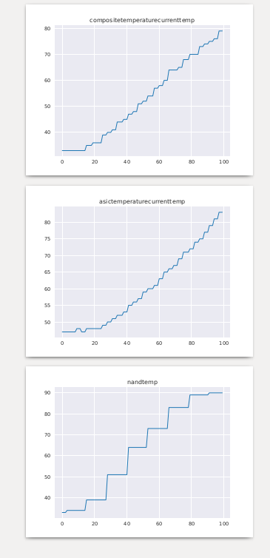
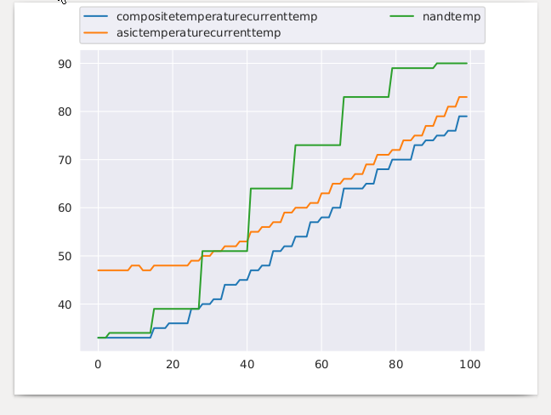
TSV Library – Generic Graphing
TSV = Time-Series Visualization
Standard time-series (TS) with combination
Standard time-series (TS) with no combination

Slide 13
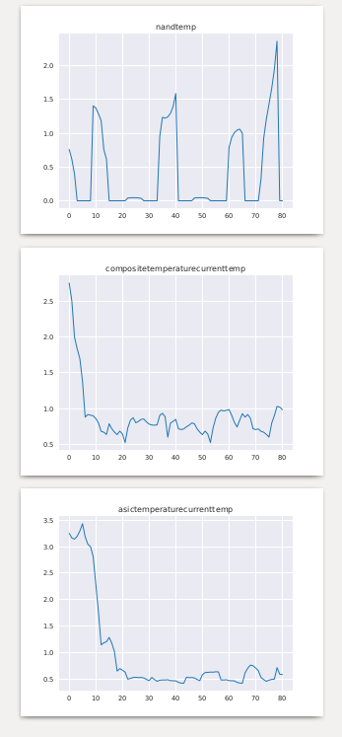
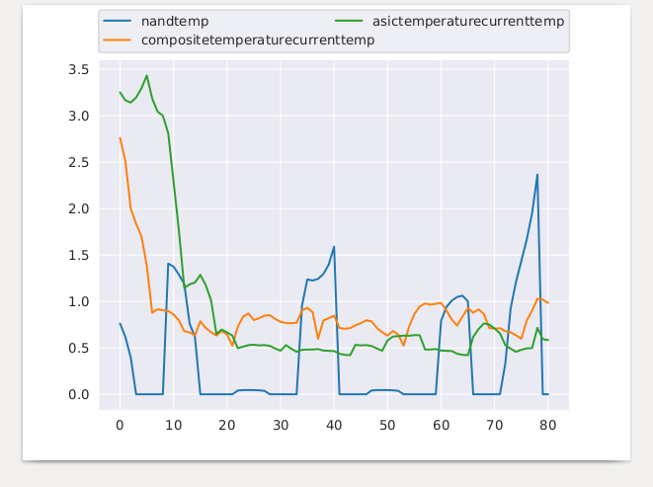
TSV Library – Generic Graphing
TSV = Time-Series Visualization
MP with no combination
Matrix profile with combination

Slide 14
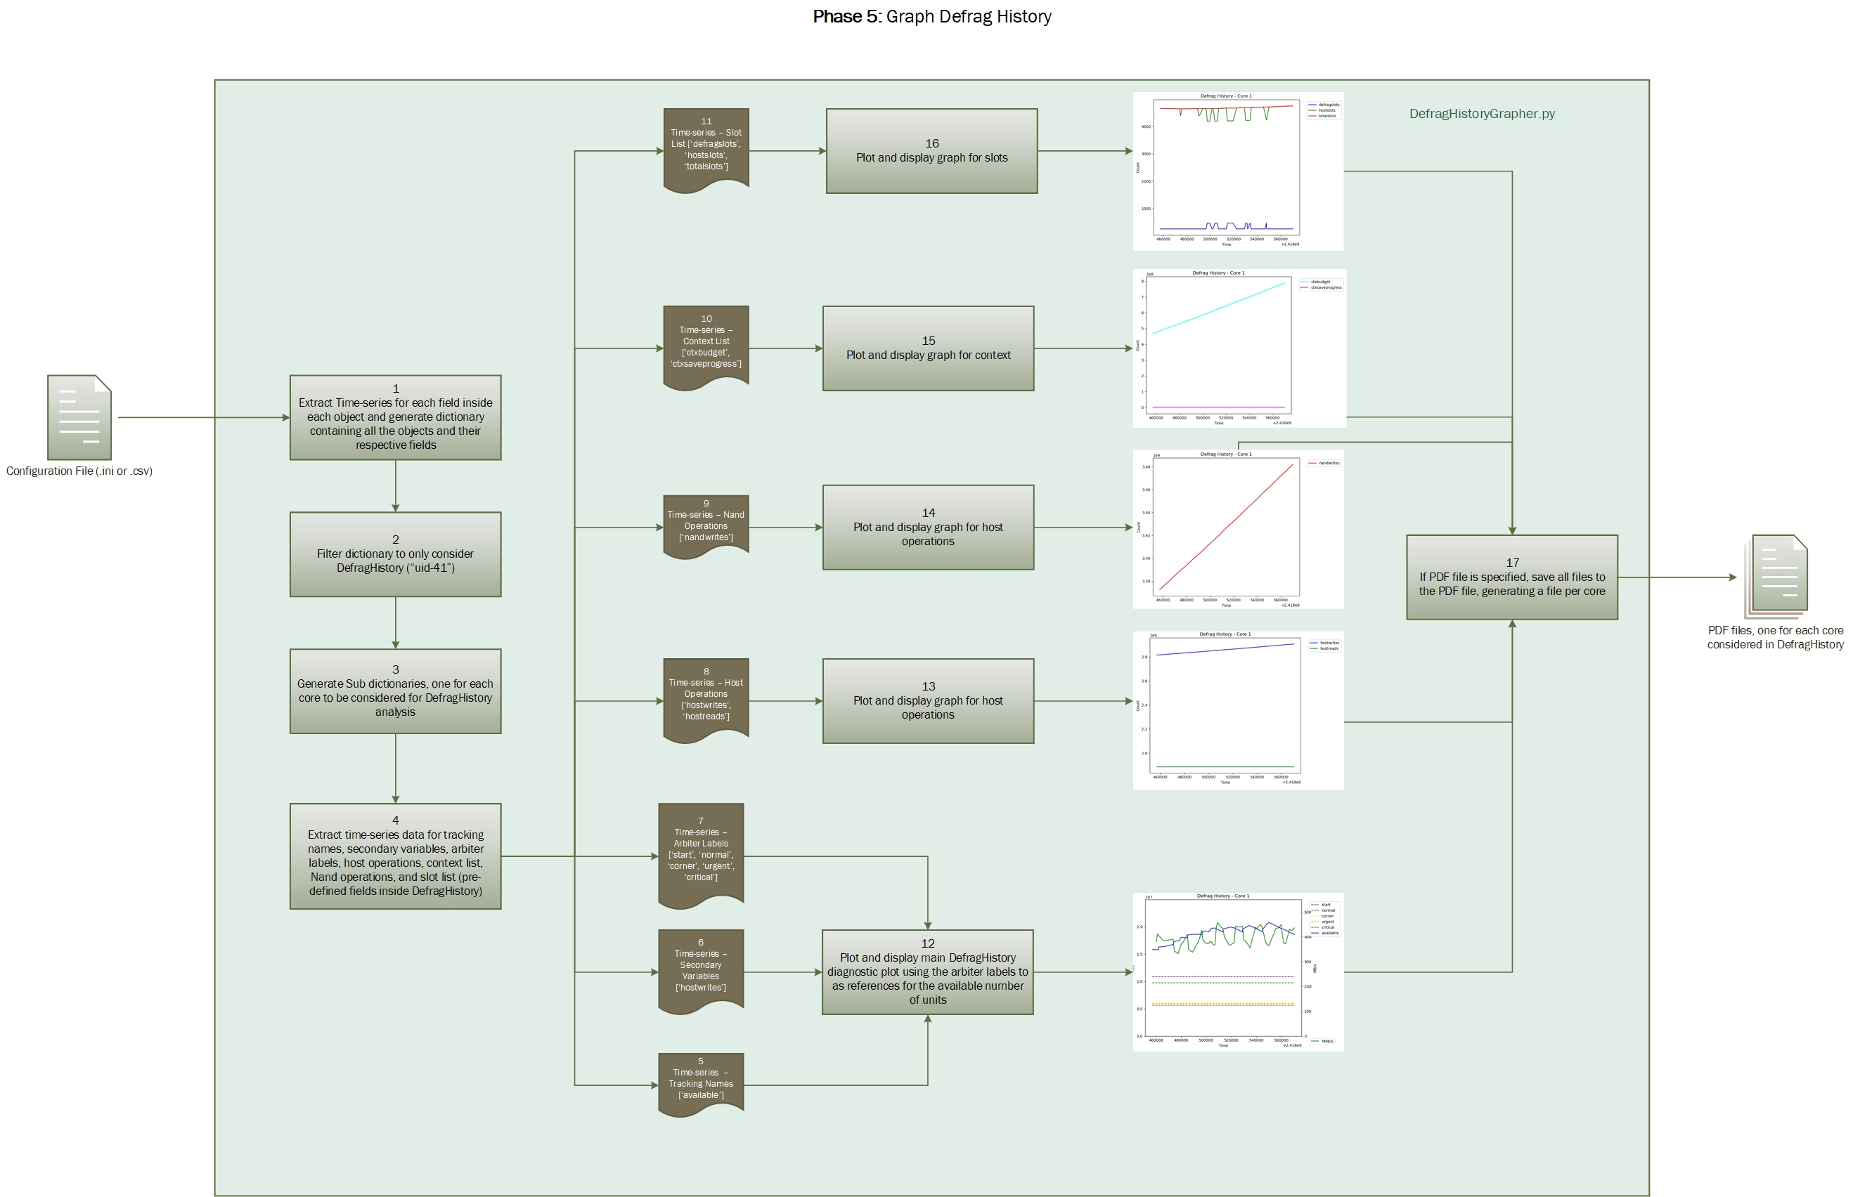
TSV Library – defrag history Graphing
TSV = Time-Series Visualization
High level description of system for graphing Defrag History

Slide 15
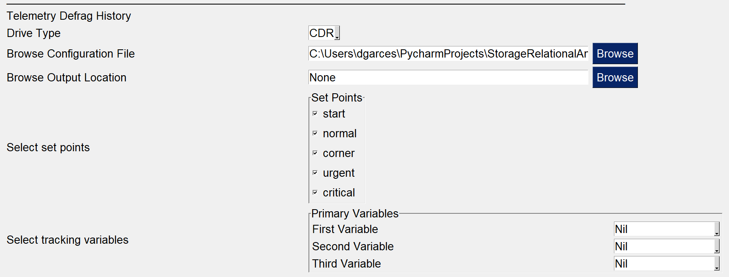
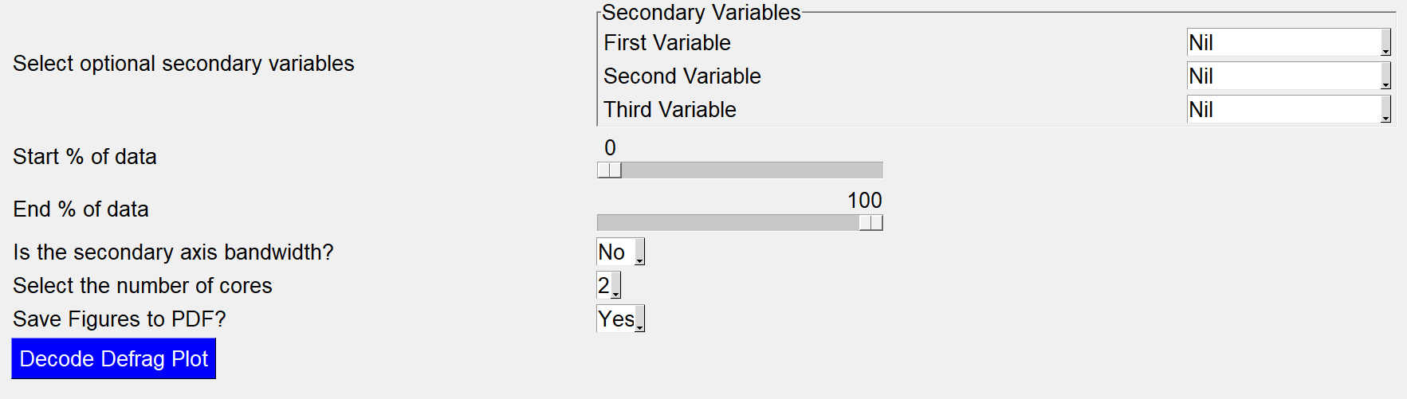
TSV Library – defrag history Graphing
TSV = Time-Series Visualization
GUI snippet of system for graphing Defrag History

Slide 16
TSV Library – defrag history Graphing outputs

Slide 17
Parse Library
GUI snippet of system for parsing telemetry’s binary files
High level description of system for parsing telemetry’s binary files

Slide 18
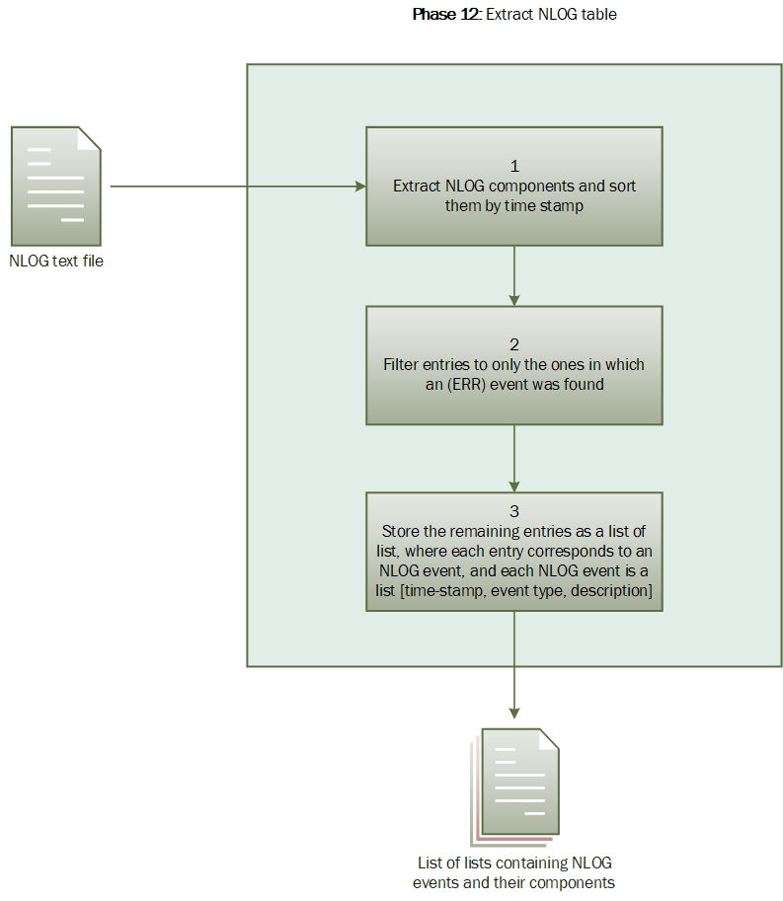
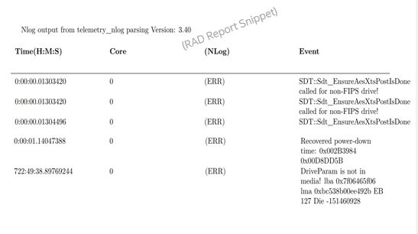
Parse Library
Parse Library
High level description of mechanism for including error NLOG events in the report
NLOG events included in the report

Slide 19
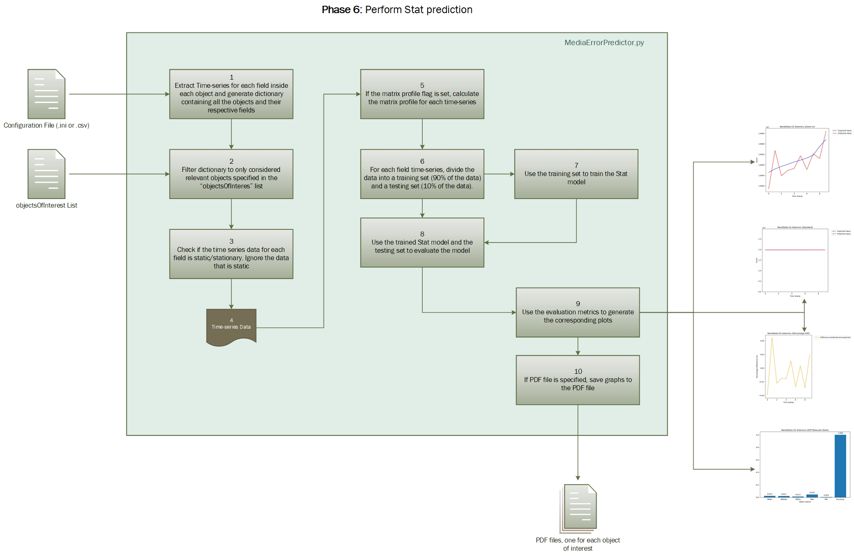
MEP library - ARMA
MEP = Media-Error-Prediction
High level description for the system for executing Stat prediction (ARMA model)

Slide 20
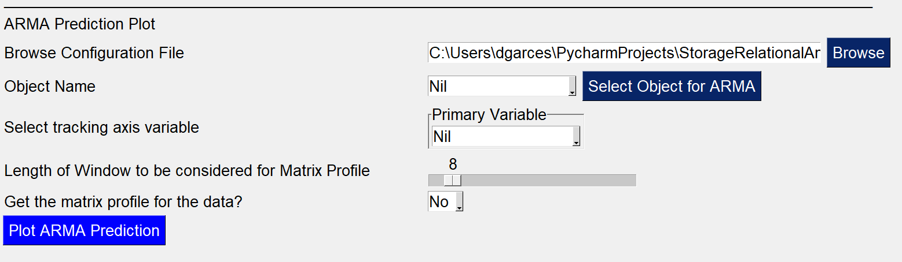
MEP library - ARMA
MEP = Media-Error-Prediction
GUI snippet for Stat predictor (ARMA model)
Output graphs for the Stats predictor (ARMA model)

Slide 21
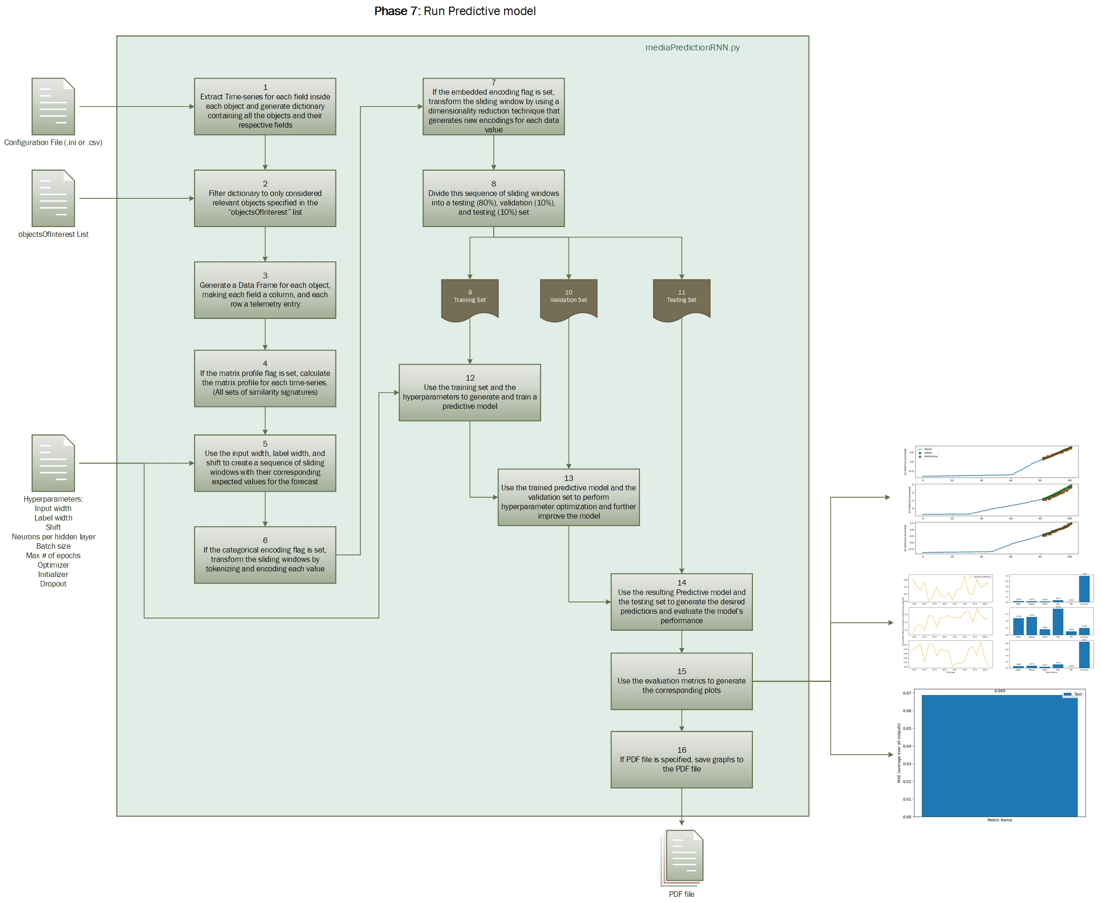
autoAI library – time series forecasting
High level description of the system for time series forecasting (RNN model)

Slide 22
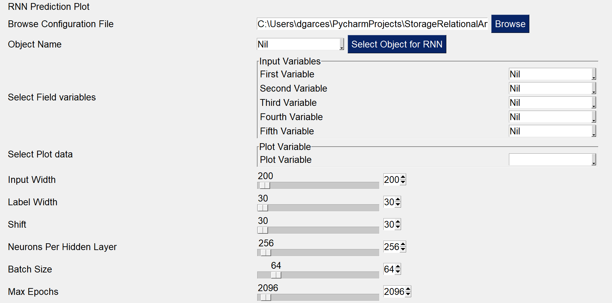
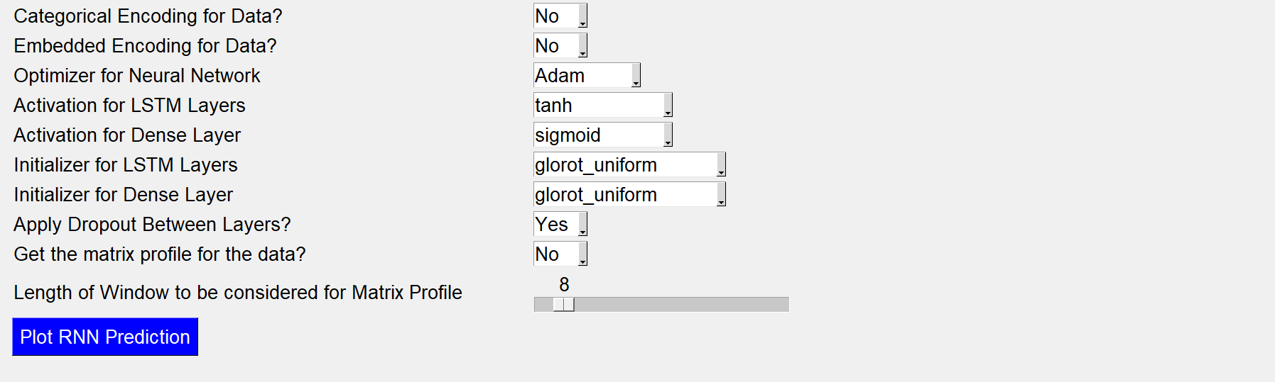
autoAI library – time series forecasting
GUI snippet for time series forecasting system (RNN model)

Slide 23
autoAI library – time series forecasting
Outputs for the time series forecasting system (RNN model)

Slide 24
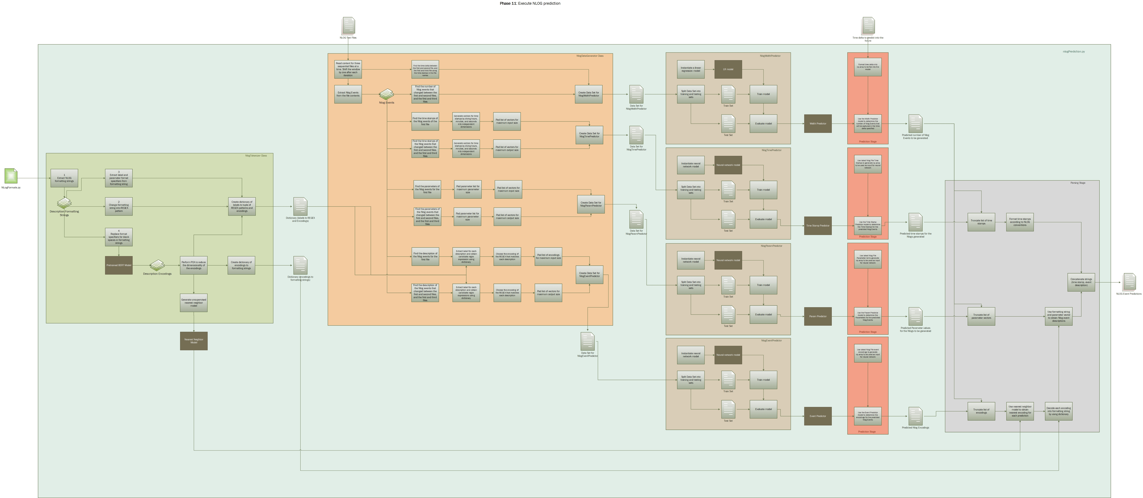
autoAI library – nlog predictor
Predictive Models
Training
NLOG Tokenizer
NLOG Description Parsing
NLOG Data Generator
Prediction Generation
High level description of the system for NLOG prediction (ensemble model)

Slide 25
nlog predictor – NLOG Tokenizer
High level description of the NLOG event tokenizer

Slide 26
nlog predictor – Data Generator
High level description of the NLOG event data generator

Slide 27
nlog predictor – Predictive Model Training
High level description of training of the multiple probabilistic models used for predicting the event encoding, time stamp, parameter value, and width of an NLOG event

Slide 28
nlog predictor – Prediction Generation
High level description of the prediction process of the multiple probabilistic models used for generating the event encoding, time stamp, parameter value, and width of an NLOG event

Slide 29
nlog predictor – NLOG Description Parsing
High level description of the parsing mechanism for generating a string representation from the predicted NLOG elements generated by the probabilistic models

Slide 30
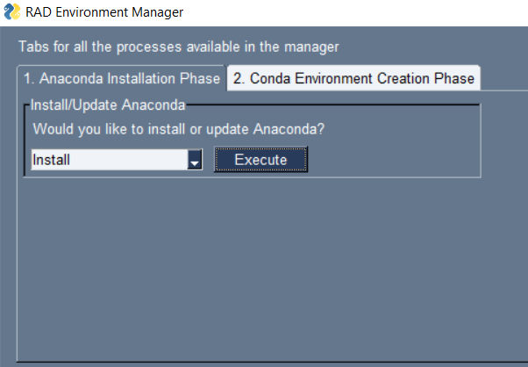
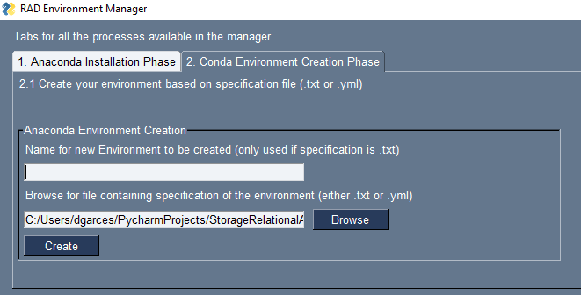
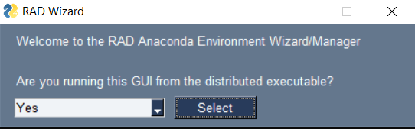
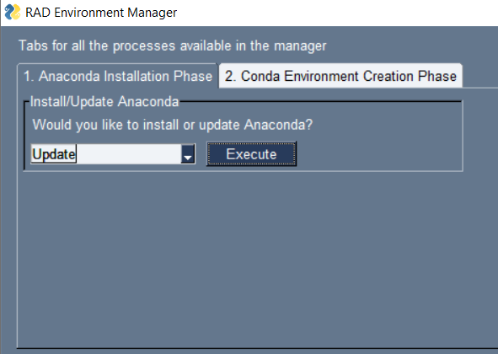
Miscellaneous Tasks
GUI snippets for the installation wizard

Slide 31
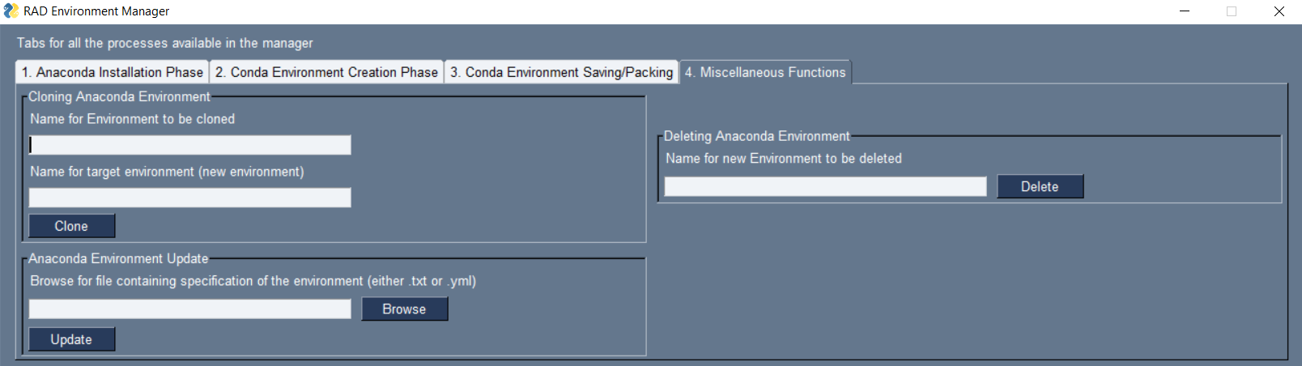
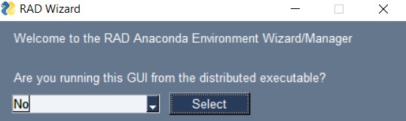
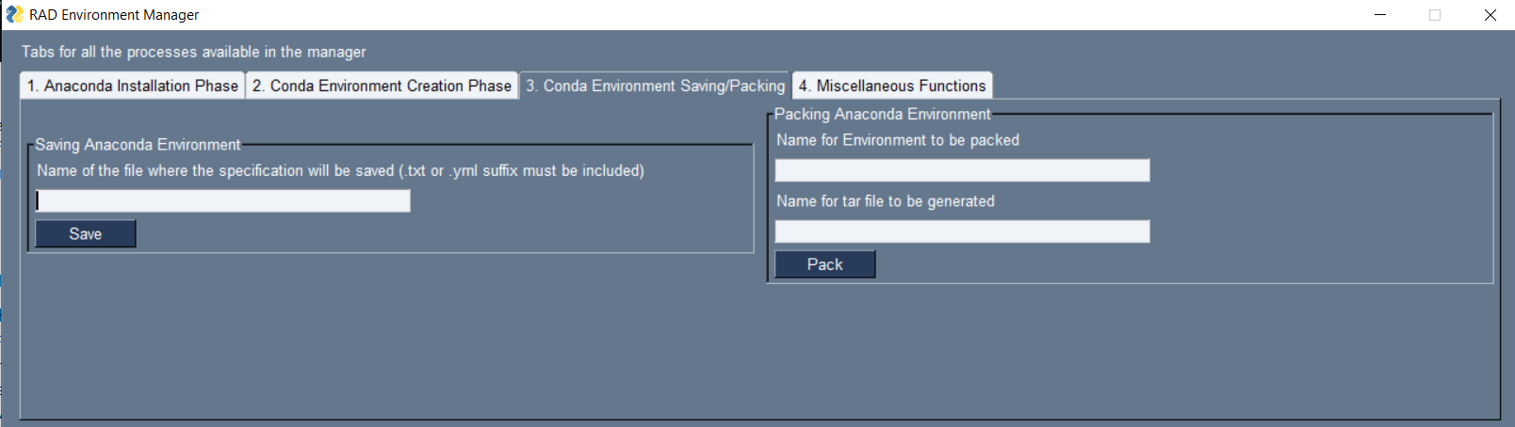
Miscellaneous Tasks
GUI snippets for the installation wizard

Slide 32
idfs and awards
Contributed to the following
Filed patents:
Method and Apparatus for Continuous Monitoring of Telemetry (CMT-API) used in Machine Programming (MP) through API(s)
Intel distinguished inventor award:
Method and Apparatus for Numerical Entity Wassailing of Similar Neural Networks (New-SNN) through Inference
IDFs to be resubmitted:
Method and apparatus for Adaptive Genetic Evolution of Neural Network joined Transformations for continuously Fitting of Personas (AGENT-FP)
Method and Apparatus to reduce the overhead of manually decoding and supporting language or machine coded data structures for use in Telemetry Labeling through automated machine programming
IDFs to be submitted:
Method and Apparatus for Logging Entry Forecasting and Failure Prediction for Technical Logs (LEF-FP)
Method and Apparatus for autonomous trust building (ATB)

Slide 33
THANK YOU
Notes:
THANK YOU

Slide 34

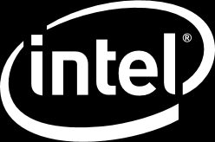
Notes:
END OF PRESENTATION

